Slide 1
Liability Doctrine

Slide 2

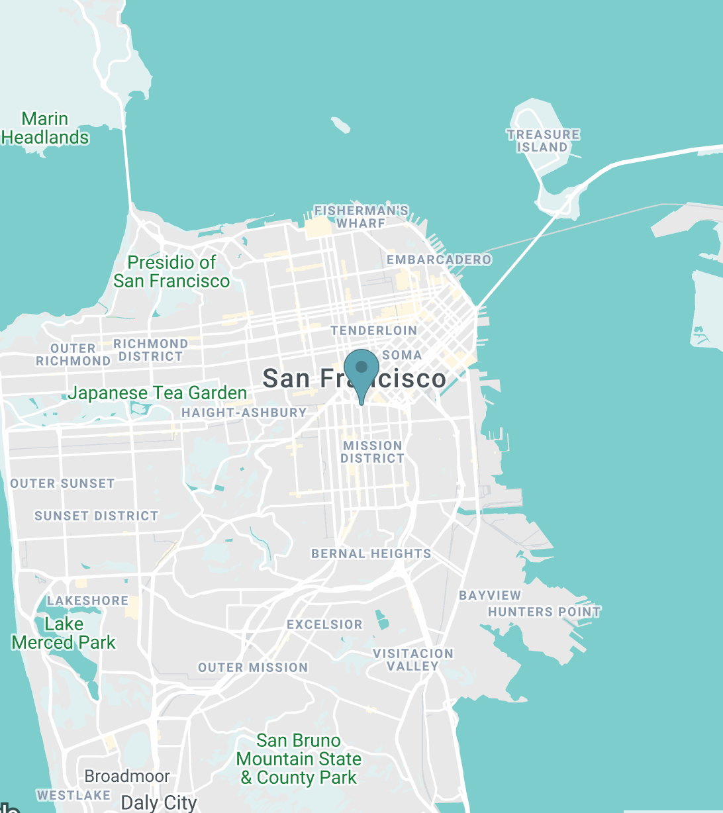
Contact Us
251 S. Van Ness Ave. San Francisco, CA 94103
1000000
LimitsTheoremCommonLaw

Slide 3

Manufacturing BIAS

Slide 4


Debate In Industries?
50%

Slide 5
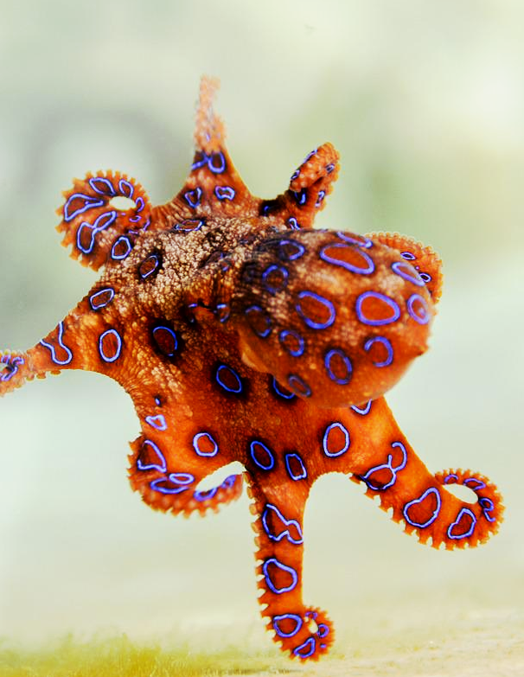













Depart
Vary
Deviate
Synonyms
DIVERGE
Antonyms
Conform
Meet
Converge

